Slide 1

Fake News Detection using
machine learning

Slide 2



TABLE OF CONTENT
Introduction Major Problem Purpose Work Flow of Project
Technologies Used Results Conclusion

Slide 3



What is a Fake News?
Fake News is a news designed to deliberately spread hoaxes, propaganda, and disinformation.
Fake News Stories usually spread
through social media sites like
Facebook, Twitter, Instagram, etc.
The wide spread distribution of fake
news has the potential to have highly
negative effects on people and culture.

Slide 4

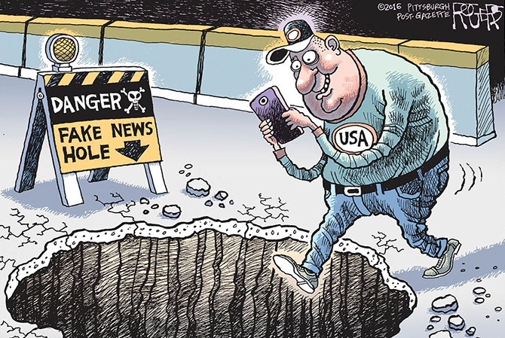

Major Problem
Fake news influences people's perception. Fake news are used as clickbait for the profit of content publishers. More clicks contributes more money to them. The rise of fake news has become a global problem that will impact people, culture as a whole and in general, doubt the authenticity of journalism as well

Slide 5





Purpose
This project aims to develop a method for detecting the news stories using machine learning. The main goal of this project is to identify and predict whether a given news article is a fake news or not. We gathered our data, preprocessed the text, and translated our articles into supervised model features.
Delimitations: Our project does not guarantee 100% accuracy.

Slide 6


Work Flow of Project
Collection of Data
Pre-processing of data
Extract Features
Content Classification
Training the model
Training the classifier

Slide 7
Techniques Used
Passive Aggressive algorithm
Data Preprocessing: Cleaning, normalizing, and transforming data into a suitable format for the algorithm.
Model Training: Feeding the algorithm with labeled data to learn the patterns differentiating real from fake news.
Model Optimization: Adjusting parameters and hyperparameters to enhance the algorithm's performance and accuracy.

Slide 8
Results
This works focus on textual news content features. Indeed, other features related to social media are difficult to acquire. For example, users information is difficult to obtain on Facebook, as well as post information. In addition, the different datasets that have been presented at style-based model does not provide any other information than textual ones.Looking at Different approaches to fake news detection it can be seen that the main focus will be made on unsupervised and supervised learning models using textual news content. It should be noted that machine learning models usually comes with a trade-off between precision and recall and thus that a model which is very good at detected fake news might have a high false positive rate as opposite to a model with a low false positive rate which might not be good at detecting them. This cause ethical questions such as automatic censorship that will not be discussed here.

Slide 9
Conclusion
The outcome of this project shows the capability of machine learning to be fruitful in this Task. We have tried to build a model that helps in catching many intuitive indications of real and fake news. We have used multiple performance matrics

Slide 10
Thank you

